Slide 1



Mapping Rheumatoid Arthritis Genes using a Novel Recessive Diplotype Approach in the Marshfield Clinic Personalized Medicine Research Project (PMRP)
Dr. Shicheng Guo, Dr. Dongyi He, Dr. Steven Schrodi
04/4/2019

Slide 2
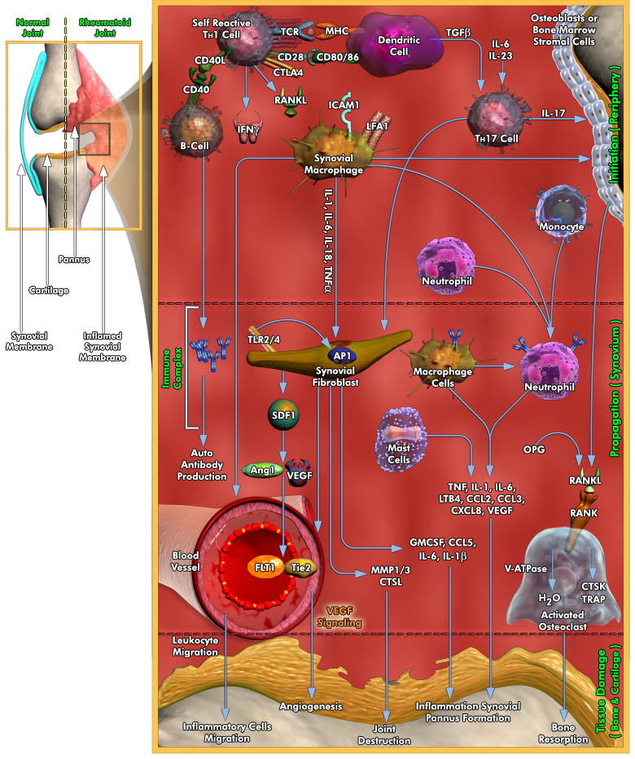
Osmotic Stress
Heat Shock
Mitogens
Pro-inflammatory cytokines
MAPK/ERK
Proliferation, Gene expression, differentiation, mitosis, cell survival, and apoptosis

Slide 3
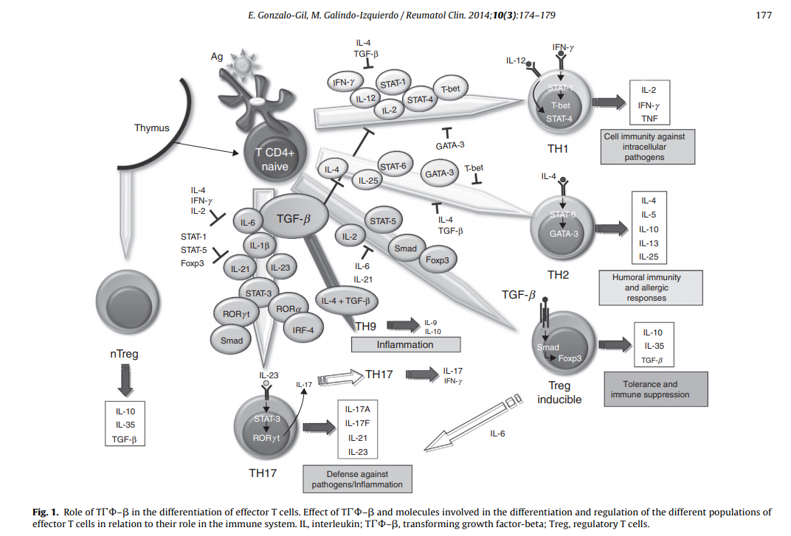

Slide 4
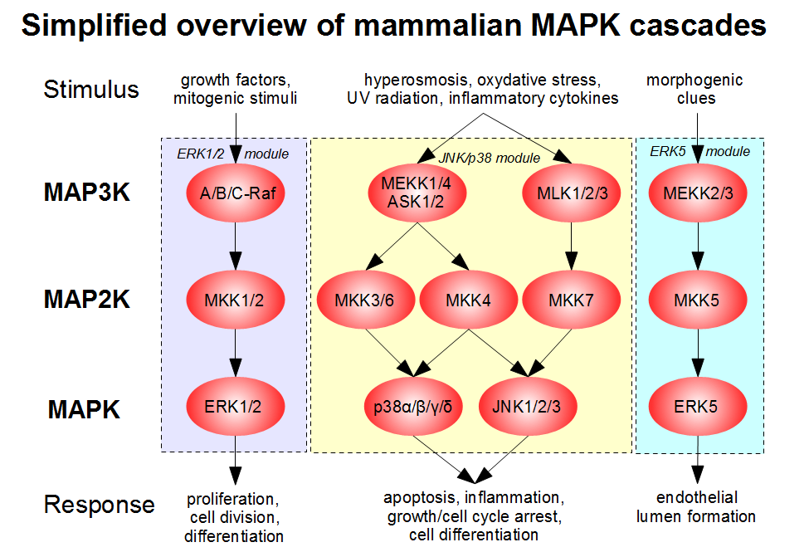

Slide 5
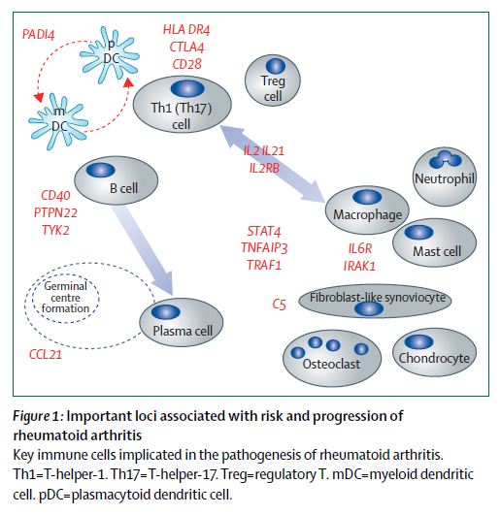
Rheumatoid arthritis,Josef S Smolen, Daniel Aletaha, Iain B McInnes. 2016, lancet, 388:2033-38

Slide 6
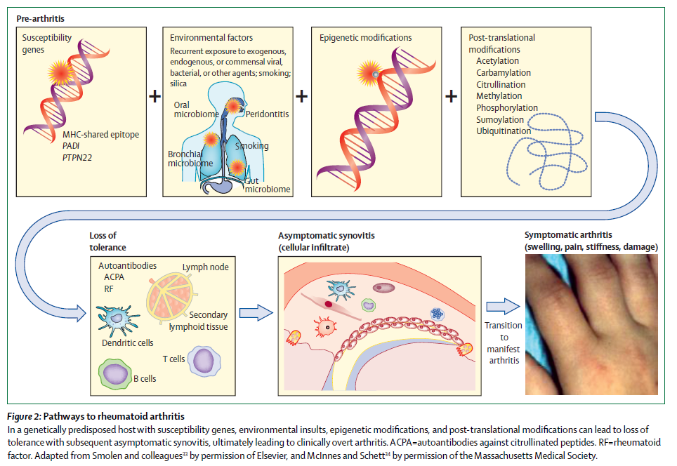
Rheumatoid arthritis,Josef S Smolen, Daniel Aletaha, Iain B McInnes. 2016, lancet, 388:2033-38

Slide 7
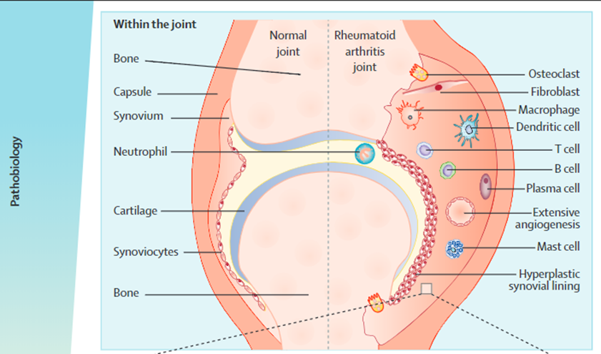
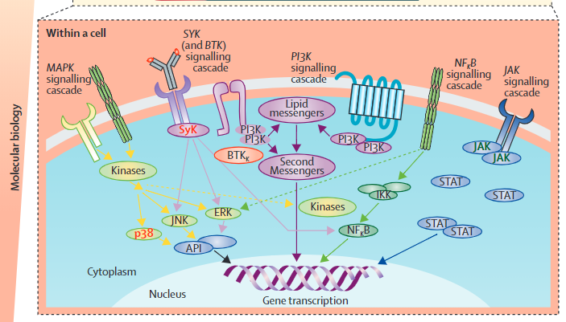
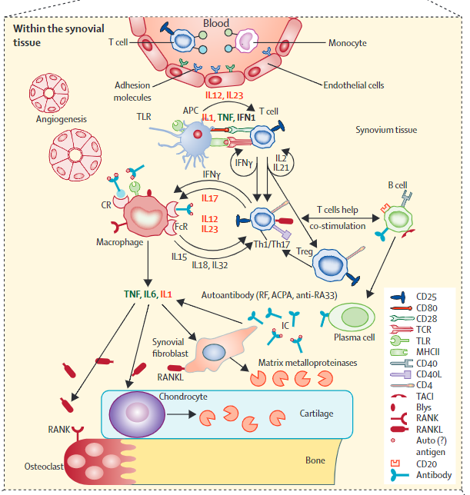

Slide 8
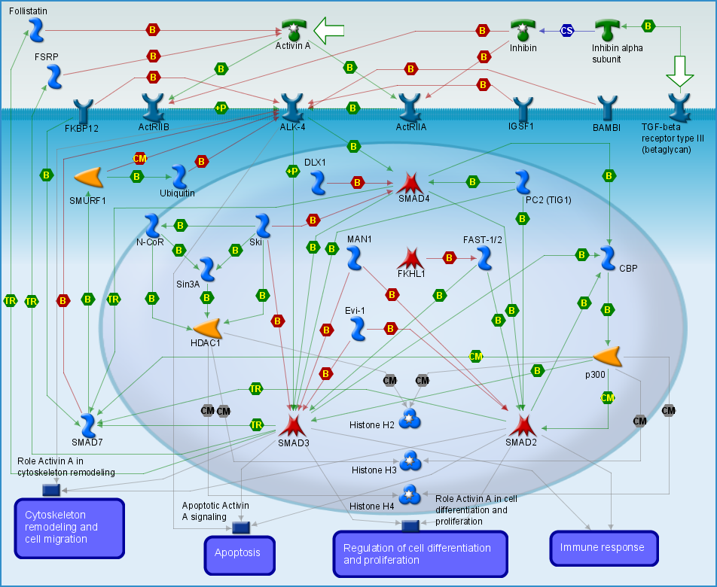

Slide 9
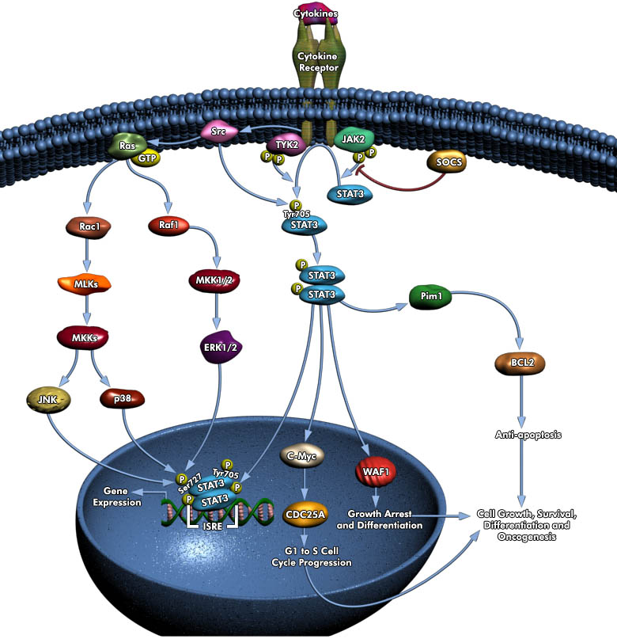

Slide 11
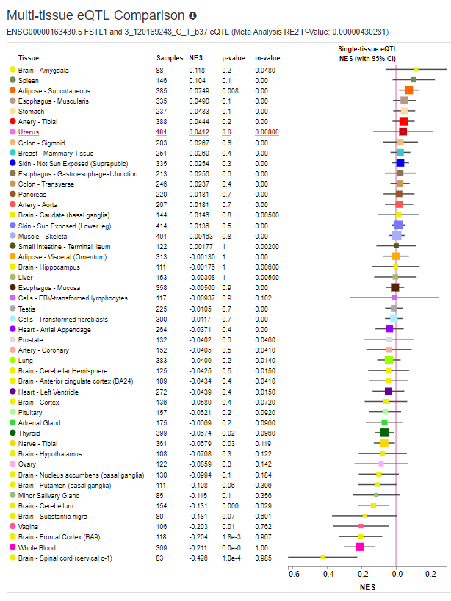
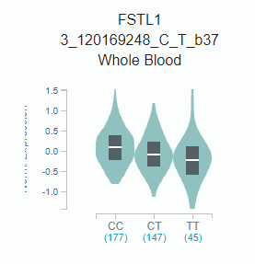
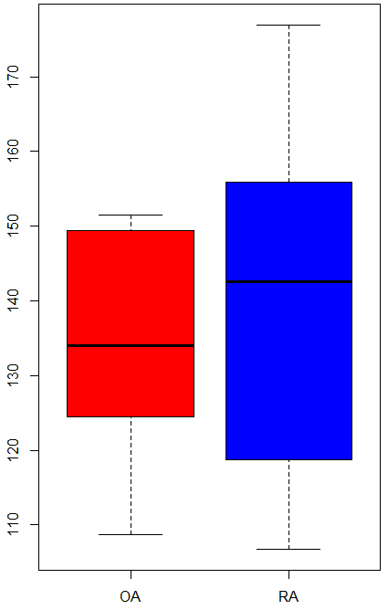
FSTL1 and Rheumatoid Arthritis
rs1147707, located in promoter region of FSTL1, is a cis-eQTL based on GTEx project, meanwhile, rs1147707 is identified by GWAS to be associated with blood pressure.
Follistatin also known as activin-binding protein is a protein that in humans is encoded by the FST gene. Follistatin is an autocrine glycoprotein that is expressed in nearly all tissues of higher animals.
rs1147707
FSTL1/Mean
RNA-seq data from GSE112658 (10 RA and 10 OA) shown FSTL1 is higher in RA compared with OA

Slide 12
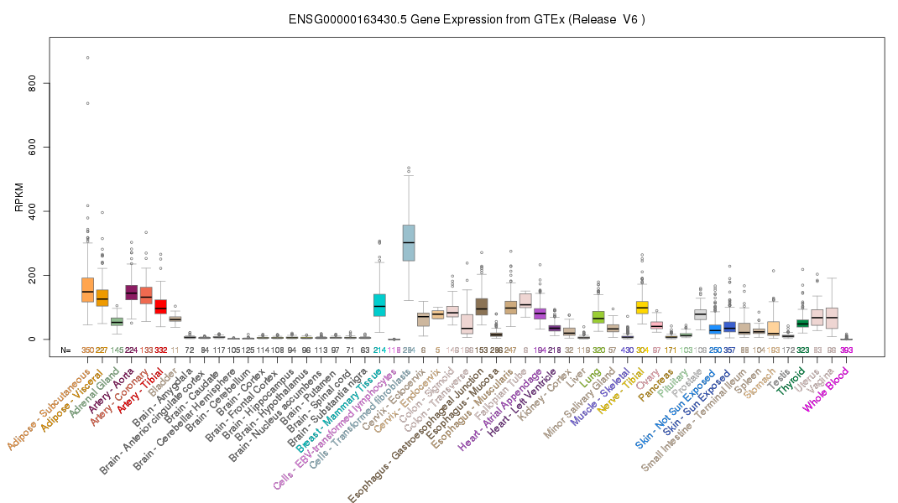
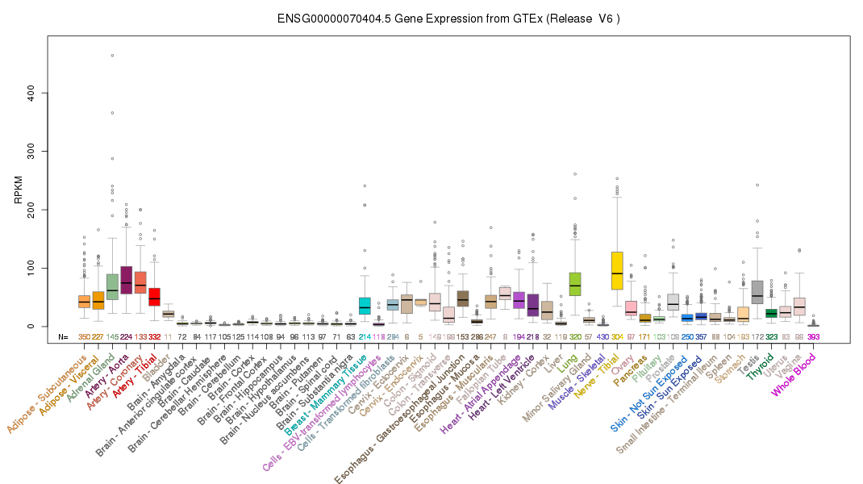
FSTL1 and FSTL3 Expression in Human Tissues

Slide 13
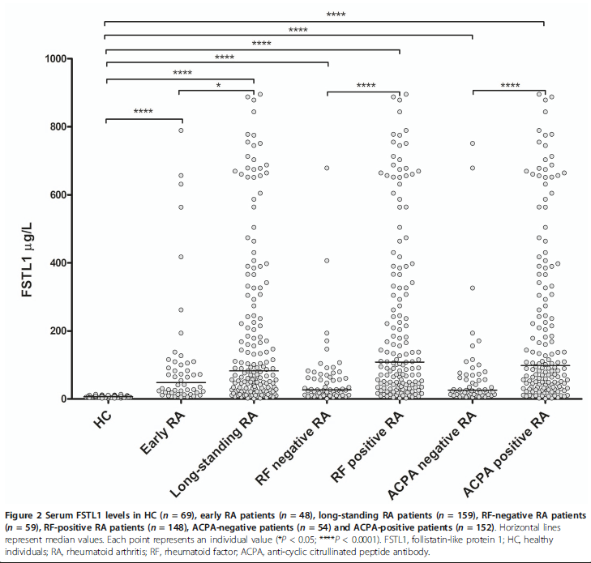
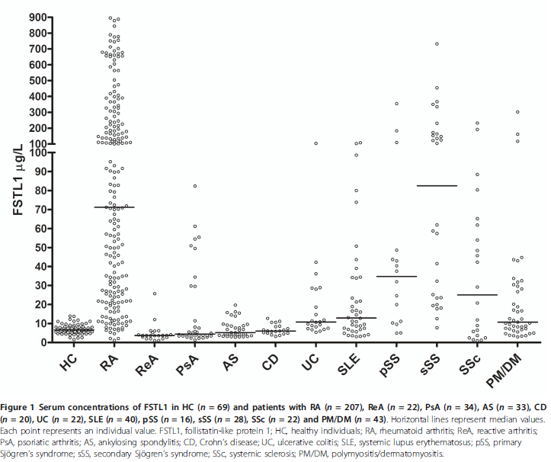
Follistatin-like protein 1 is elevated in systemic autoimmune diseases and correlated with disease activity in patients with rheumatoid arthritis

Slide 14
FSTL1 and Rheumatoid Arthritis
Step A: Genome-wide IBD Scanning for rheumatoid arthritis in 20,000 PMRP dataset
1) Manhattan plot: Done
2) qq-plot: Done
3) Structure and functional domain analysis: Done
Step B: Genome-wide IBD Scanning for rheumatoid arthritis in 20,000 PMRP dataset
1) different variant have different ability to combined with CD14, TLR4
2) different variant have different ability to increase p-STAT4
3) different variant have different ability induce IL-6, HAMP, IL-8
Step C: Mouse model to validate FSTL1 and CCR7 effect to phenotype
1) different mutated mouse model to shown different phenotypes (submitted)

Slide 15
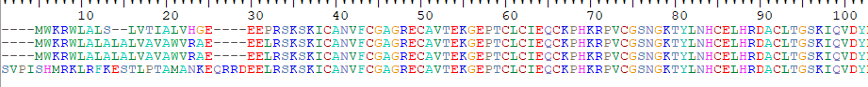
Figure 2. Protein sequence alignment for FSTL1 and functional domains
Follistatin-N-terminal Domain-Like
Kazal-type Serine Protease Inhibitors Domain
rs1147707 (eQTL)
rs374114238 (P>A)
rs199556968 (D>N)
_{Mus musculus}
_{Homo sapiens}
_{Pan troglodytes}
_{Puma concolor}
rs113155123 (E->G, Deleterious, WGAS)
EFh_SPARC_FSTL1
rs199863523 (N>D)
rs150197564 (R>C)
EF-hand domain
Von Willebrand Factor (vWF) type C Domain
rs754750214(E->K/Q)
TGF-beta, CD14, DIP2A, TLR4, Activin A, Activin B, Activin AB
FSTL1 contains 4 important domains: Follistatin-N-terminal Domain, Kazal-type serine protease inhibitor domain, EF-hand domain, vWF type C domain.
Follistatin-N-terminal Domain binds to activin and is a specific inhibitor of the biosynthesis and secretion of pituitary follicle stimulating hormone. Kazal-type inhibitors represent the most studied canonical proteinase inhibitors. vWF type C domain usually used to bind with other proteins.
Notes:
Kazal-type inhibitors represent the most studied canonical proteinase inhibitors. Kazal inhibitors are extremely variable at their reactive sites. However, some regularity prevails such as the presence of lysine at position P1 indicating strong inhibition of trypsin [(PUBMED:10708867)].
The Kazal inhibitor has six cysteine residues engaged in disulfide bonds arranged as shown in the following schematic representation:
+------------------+ | | *******************|*** xxxxxxxxCxxxxxxCx#xxxxxCxxxxxxxxxxCxxCxxxxxxxxxxxxxxxxxC | | | | | +-------------|-----------------+ +----------------------------+ 'C': conserved cysteine involved in a disulfide bond. '#': active site residue. '*': position of the pattern.
The structure of classical Kazal domains consists of a central alpha helix, which is inserted between two beta-strands and a third that is toward the C terminus [(PUBMED:6752426)]. The reactive site P1 and the conformation of the reactive site loop is structurally highly conserved, similar to the canonical conformation of small serine proteinase inhibitors.

Slide 16
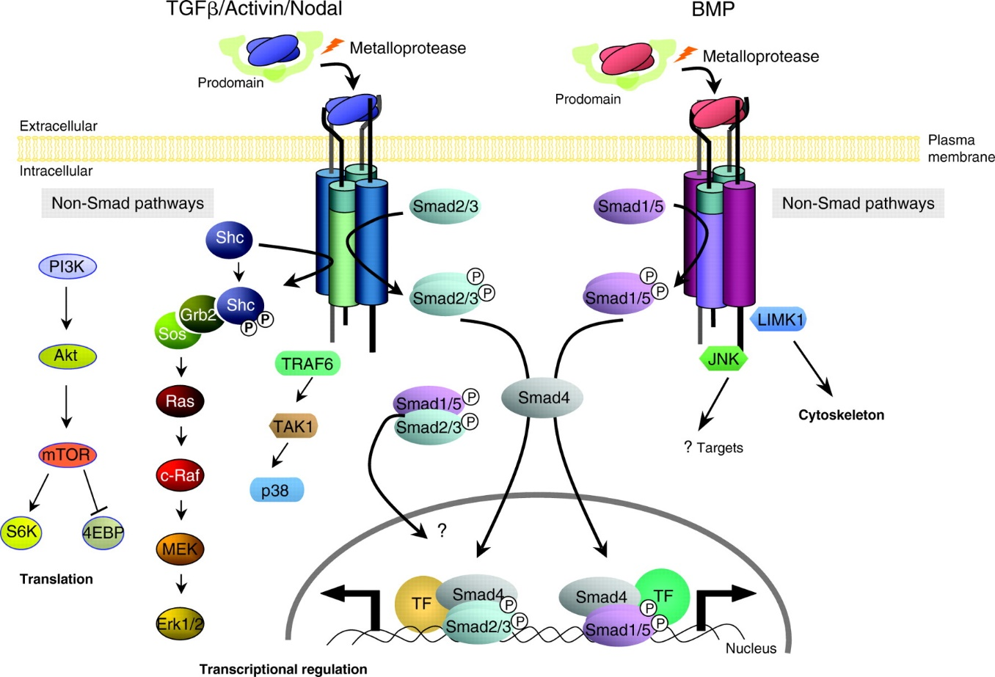
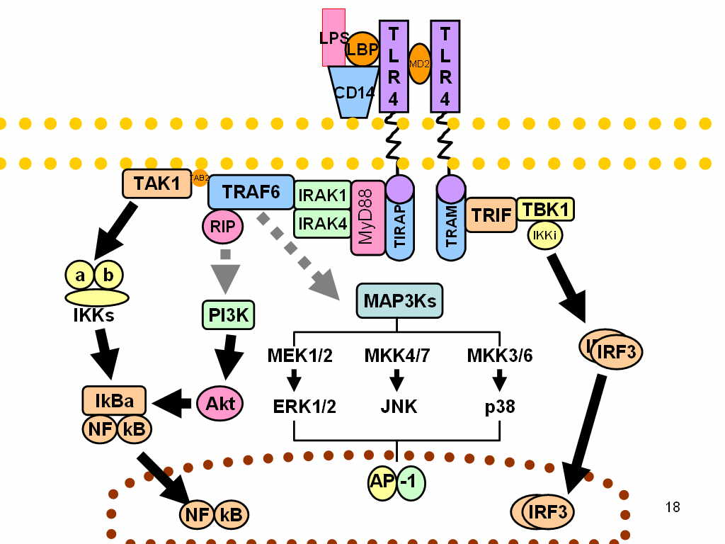
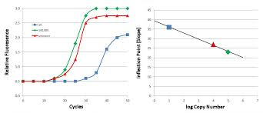
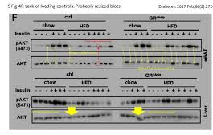
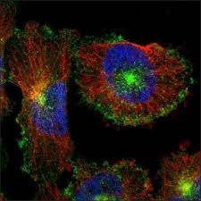
FSTL1 and Rheumatoid Arthritis
FSTL1
DIP2A
NF-κB
IL-6, STAT-3, Hepcidin
IL-6
LBP: lipopolysaccharide binding protein
FSTL1 with different variants stimulate CD14+ cells and check the gene expression of IL-6, HAMP and pSTAT-3
Collect mRNA – IL6, IL-8, HAMP
Collect protein: p-STAT3, p-NF-kB
Collect supernatants: Elisa-IL6
Immunofluorescence for TLR4

Slide 17
Figure 1. Protein sequence of FSTL1 in human
>NP_009016.1 follistatin-related protein 1 precursor [Homo sapiens] MWKRWLALALALVAVAWVRAEEELRSKSKICANVFCGAGRECAVTEKGEPTCLCIEQCKPHKRPVCGSNG KTYLNHCELHRDACLTGSKIQVDYDGHCKEKKSVSPSASPVVCYQSNRDELRRRIIQWLEAEIIPDGWFS KGSNYSEILDKYFKNFDNGDSRLDSSEFLKFVEQNETAINITTYPDQENNKLLRGLCVDALIELSDENAD WKLSFQEFLKCLNPSFNPPEKKCALEDETYADGAETEVDCNRCVCACGNWVCTAMTCDGKNQKGAQTQTE EEMTRYVQELQKHQETAEKTKRVSTKEI

Slide 18
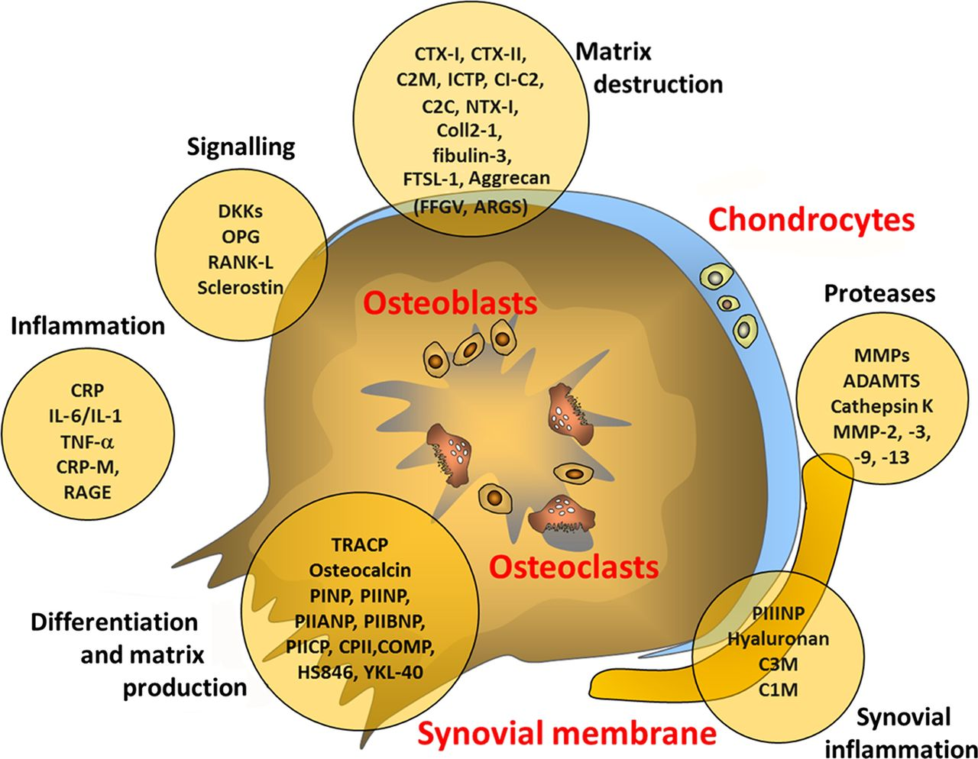
Value of biomarkers in osteoarthritis: current status and perspectives

Slide 19
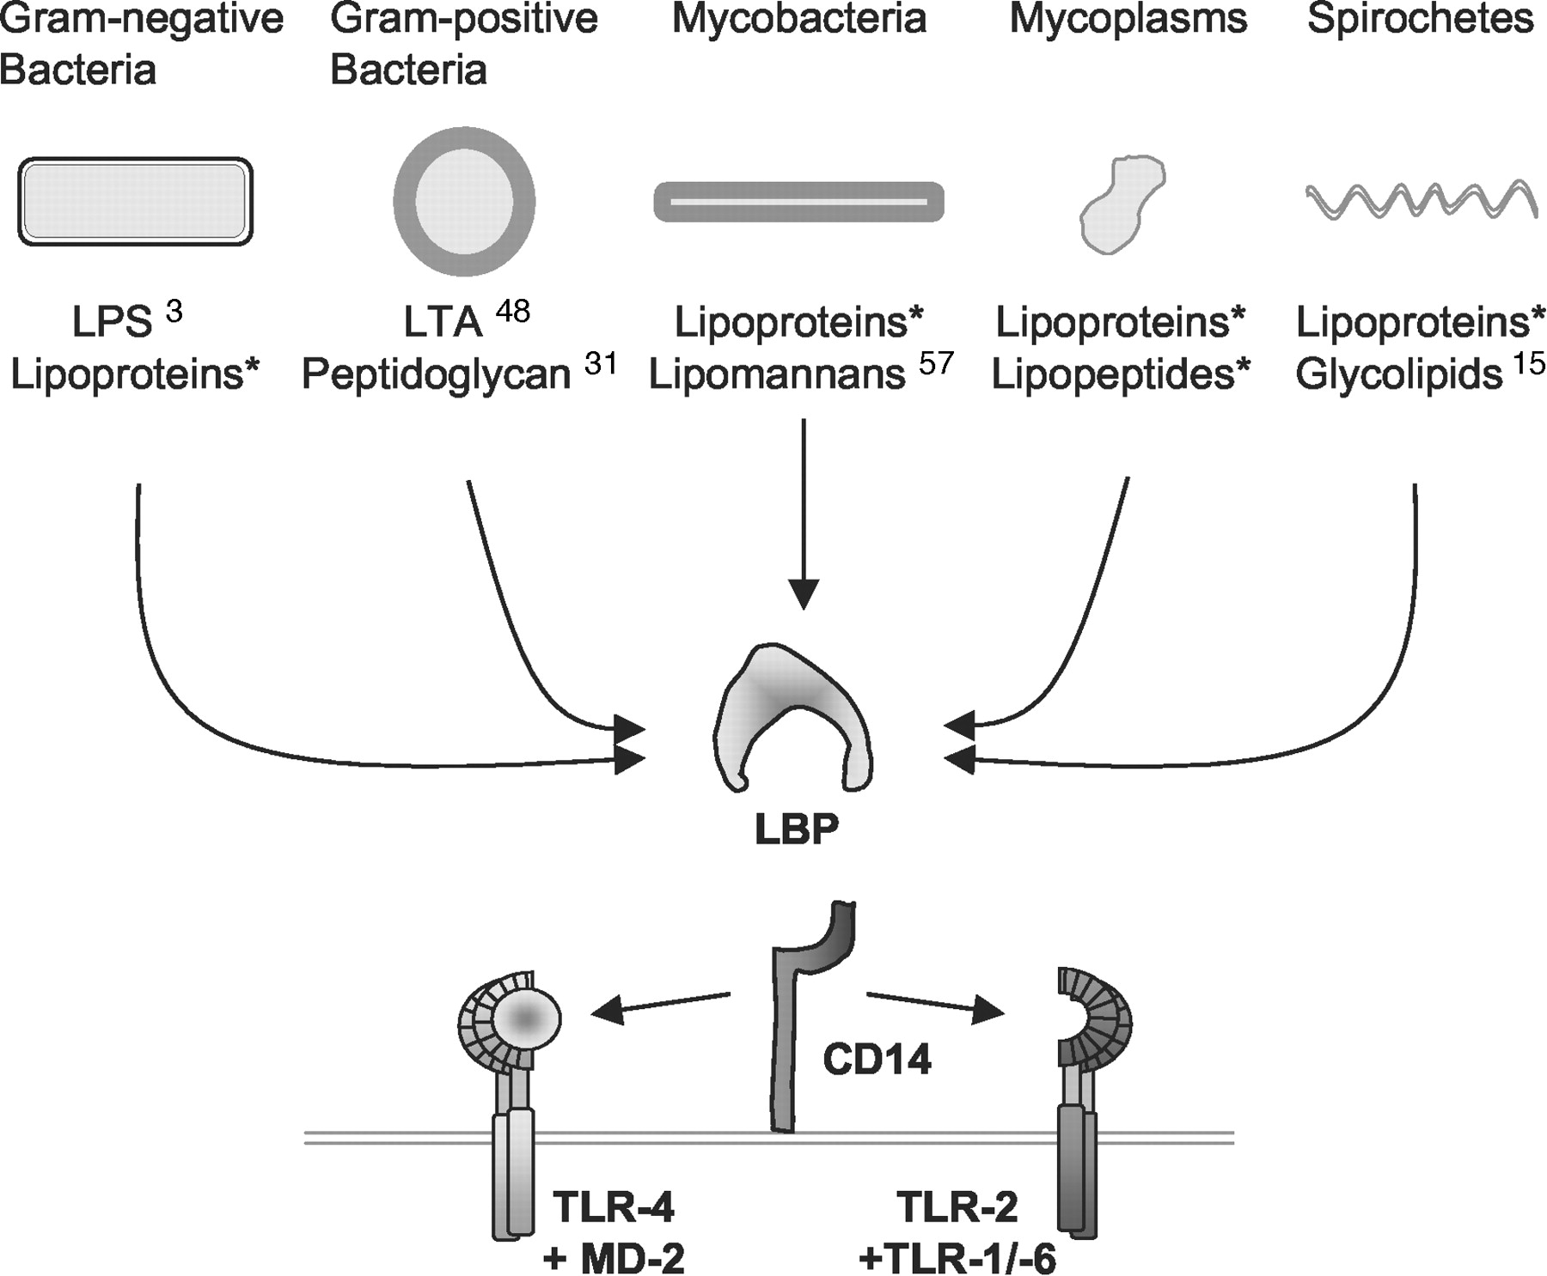
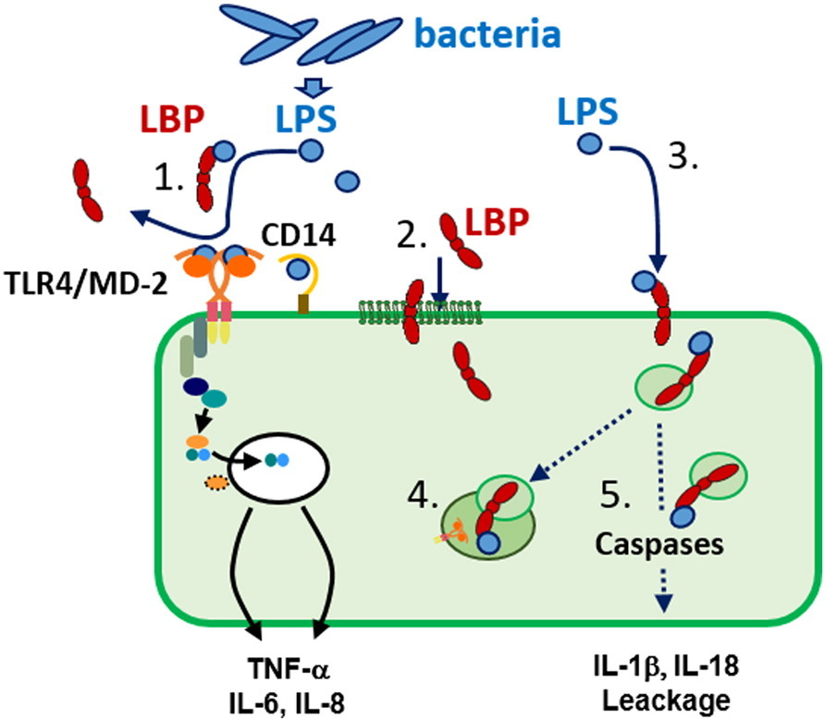
Lipopolysaccharide-binding protein is bound and internalized by host cells and colocalizes with LPS in the cytoplasm: Implications for a role of LBP in intracellular LPS-signaling

Slide 20
_{Later, to do some test} to select 2-4 SNPs for functional validation
Chi-square based single SNPs association showed
Raw Phase 1 data without imputation
Phase 1 data with imputation

Slide 21
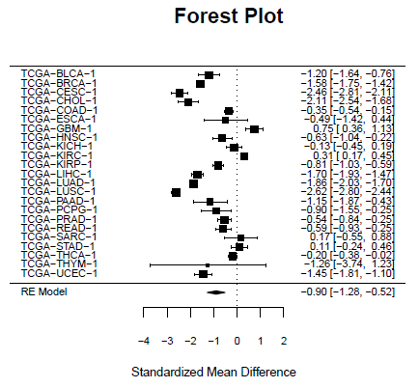
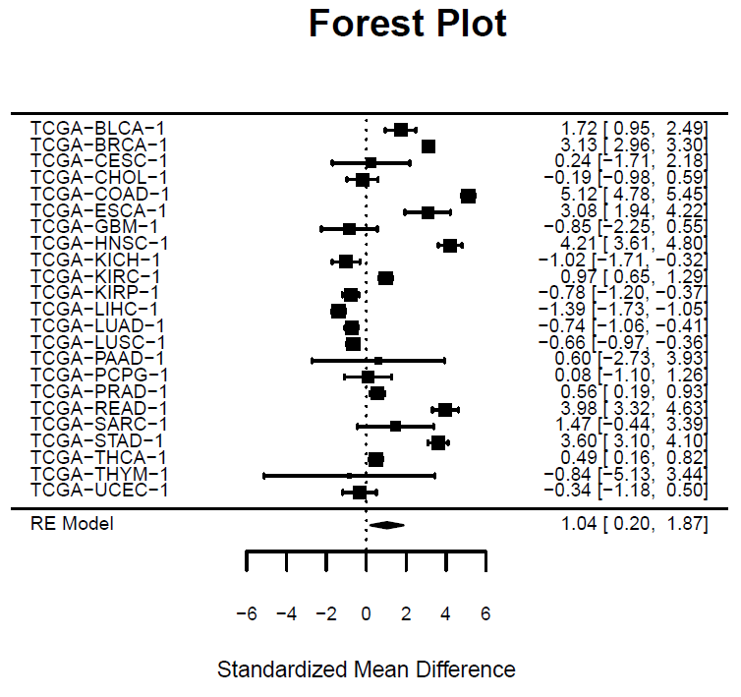
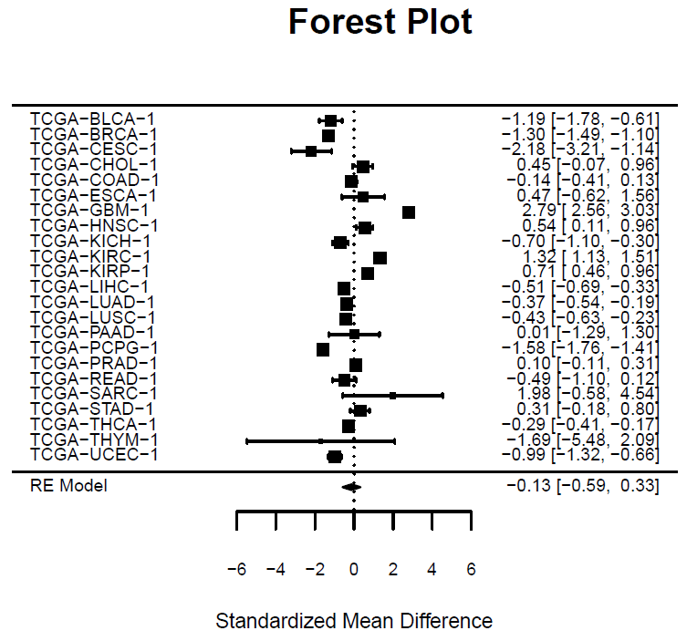
TLR4
Activin (INHBA)
RE Model for All Studies (beta = −0.90, se = 0.19, zval = −4.61; P = 4.01E−06)
CD14,
FTSL1
RE Model for All Studies (beta = −0.13, se = 0.23, zval = −0.56; P = 5.76E−01)
RE Model for All Studies (beta = 1.04, se = 0.42, zval = 2.44; P = 1.46E−02)

Slide 22
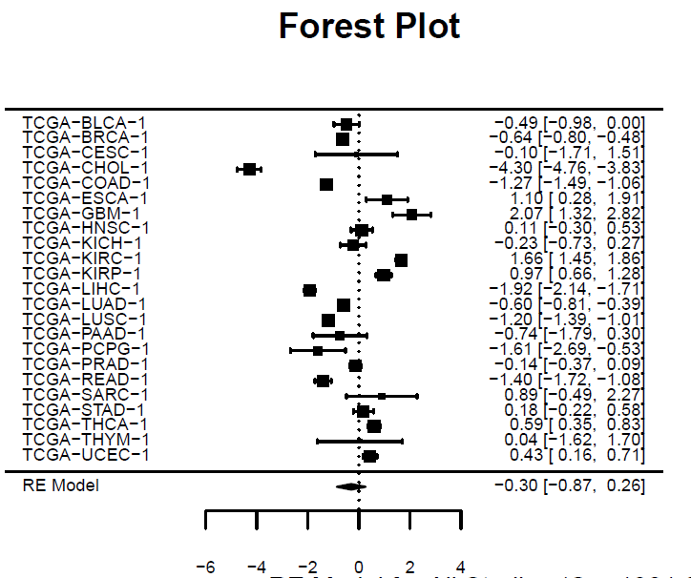
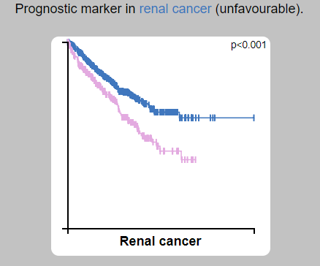
Figure x. transcriptional level and cancer survival times
_{CD14}
_{CD14}

